Slide 1


Fundamentos de Deep Learning para Processamento de Linguagem Natural
Parte 2
Dr. Cristian E. Muñoz Villalobos

Slide 2
Text Classification

Slide 3
Sumário
Redes Neurais Recorrentes e LSTMs
O Problema de Atribuição de Autoria
The Federalist Papers Lab - Suposições e Arquitetura da Rede
https://github.com/crismunoz/NLP_Course/tree/master/3.%20Fundamentals%20of%20Deep%20Learning%20for%20Natural%20Language%20Processing%20(Portuguese)

Slide 4
Neuronio recorrente
y
y_{t-1}
y_{t}
y_{t+1}
y_{t+1}
s
s_{t-1}
s_{t}
s_{t+1}
s_{t+2}
x
x_{t-1}
x_{t}
x_{t+1}
x_{t+1}
Unrolling in Time
Notes:
In the previous lab, we encountered Fully-Connected (FC) neural networks. We would either go forward (from layer i to i+1) when propagating information or backwards (from layer i+1 to i) when propagating the error. At no point did we go in a horizontal direction inside the same layer.
Often we wish to use neural networks with sequence inputs or outputs: in other words, our input/output consists of different values at different timesteps. For that, we need to use recurrent neural networks (RNNs). As shown in the example here, at each timestep we have different inputs (the X’s) and different outputs (the y’s). Additionally, we have the state from the previous timestep (the S’s) as input (with the initial state typically being the 0 vector).
The algorithm used to train RNN’s is just the usual backpropagation, applied to subsequent timesteps and hence known as Backpropagation-Through-Time (BPTT).

Slide 5
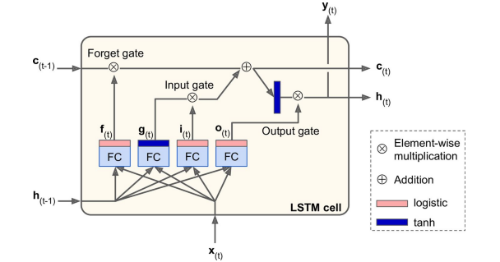
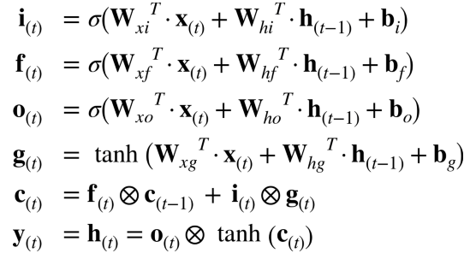
Long Short Term (LSTM)
Notes:
Regular RNN’s are notoriously difficult to train. Because of the multiple timesteps, error gradients often tend to either shrink (‘vanish’) or grow (‘explode’) exponentially. This means that vanilla RNNs have difficulty with long sequences such as the ones we need for dealing with long text sequences.
A modification to the standard RNN is the Long Short-Term Memory (LSTM) cell, which overcomes many of the issues just mentioned. Essentially, it is a set of multiple neurons known as gates along with a memory cell. At each timestep, the cell receives input (x) along with the cell contents (c) and hidden state (h) from the previous timestep. The gates have the following functions:
Forget gate – what parts of the memory cell should be ‘forgotten’
Input gate – what parts of the input should be applied to the memory cell
Output gate - what parts of the memory cell should be exposed in the output of the cell
The new hidden state and memory cell state are then propagated to the next time step. The parameters are learned as usual using BPTT.

Slide 6
Atribuição de autoria
Dado um conjunto de documentos e um conjunto de autores, quais autores escreveram quais documentos?
Precisamos aprender o "estilo" de cada autor: palavras e frases comuns, comprimento da frase, uso de pontuação, etc. Isso é conhecido como a ciência da estilometria.
Notes:
The problem we will deal with in this lab is the problem of Authorship Attribution: given multiple documents and multiple authors, assign the correct author or authors to each document. This is known as Stylometry. There has been a lot of research done on the various features that can help us identify author style. Since we using Deep Learning, however, we will be learning specific features ourselves.

Slide 7
The Federalist Papers
Conjunto de 85 documentos escritos entre 1787 e 1788 por Alexander Hamilton, James Madison e John Jay sob um pseudônimo e com o objetivo de promover a ratificação da Constituição dos Estados Unidos.
A autoria de 12 desses artigos é disputada entre Hamilton e Madison
Tentaremos usar o Deep Learning para resolver a questão!
Notes:
This lab will attempt to assign either Alexander Hamilton or James Madison as the author of each one of the disputed papers. We will learn the style of each author from known papers and have the network infer the author for the unknown ones.
Alexander Hamilton
Ex-Secretário do Tesouro dos Estados Unidos
James Madison
4º presidente dos Estados Unidos
John Jay
Ex-Chefe de Justiça dos Estados Unidos

Slide 8
Suposições
Apenas um único autor por documento - Hamilton ou Madison
O estilo do autor é consistente em vários documentos
Notes:
For this lab we make the following assumptions:
There is only one author per document, and it is either Hamilton or Madison. In practical terms, this means that we ignore the papers written by John Jay, and do not take into account an ‘unknown’ author or a collaboration between Hamilton and Madison.
The author’s style is consistent across all documents and does not change with time, topic, etc.

Slide 9
Arquitetura dA rede
AH or JM
Classifier
FC
Style Vector
Style Extractor
LSTM
Character Embeddings
FC
Input Sequence
Notes:
Network architecture is as follows:
We break each document down into multiple character sequences and label them with the author of the document. The reason for this is that we have a small corpus of relatively short documents, so training a language model on words is likely to overfit. We therefore use character sequences as our inputs so we have hundreds of thousands of such sequences. Note that our preprocessing of input data lowercases the text but retains punctuation as these are important for determining author style.
We learn embeddings for each character. This may seem counter-intuitive: we actually increase the dimensionality of our input! However, as we saw in the previous lab, embeddings learn useful features from the domain. In this case, these features apply directly to the author style we’re looking for.
We proceed by feeding the (embedded) character sequence to an LSTM cell. This is where we do the actual learning of style features. We take the output of the final timestep of the LSTM Style Extractor as our output (discarding all previous timesteps) and treat it as an encoding of the style of the sequence. We will also look at a 2-D representation of these vectors – if our network does a good job, we will see a distinct clustering of AH vs. JM vectors.
Finally, we feed the style vector into a multi-layer, fully-connected classifier that outputs AH or JM as output. We compare this output with the ground-truth during training for determining the error. During inference, we count the number of AH/JM sequences, and the ‘winner’ is considered to be the author of the disputed document.

Slide 10
Conclusões
RNNs podem ser usados para treinamento em sequências - LSTMs fornecem uma variante fácil de treinar.
Usamos LSTMs para aprender e codificar o estilo de sequências de caracteres dos documentos federalistas (“The Federalist Papers”)
Determinamos o autor de um documento determinando qual autor escreveu mais sequências em um documento disputado de Artigos Federalistas

